Slide 1

Internet Of Things

Slide 2
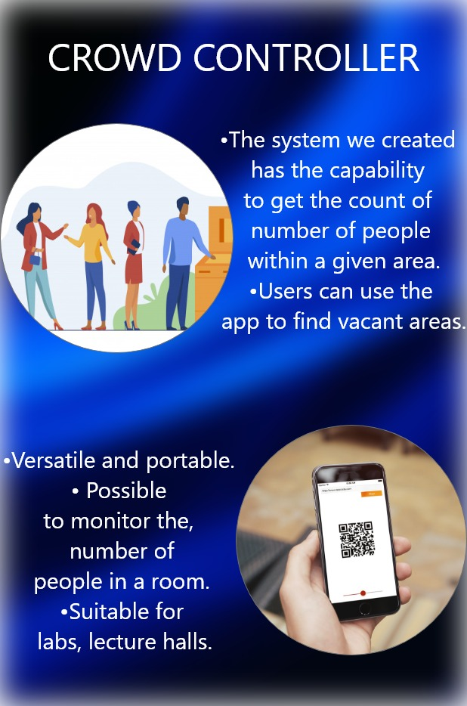

Slide 3

Introduction
The problem : We are aiming to reduce the over crowdedness of people gathering in closed areas such as a lecture hall, buses and other places.
The solutions : We developed CROWD CONTROLLER, a device that can be used to help you with controlling the amount of people gathering around to an extent.
You now have an ideal device to check how many people gather at a certain point.'

Slide 4
The Hardware
With the hardware we can now count the people coming in and out of the designated area.
This live count is sent to the database which is then retrieved by the app and the website and shown to user and also to the admin.

Slide 5
The App
We have created an app for this system, this app has the capability to scan a QR code, once QR code is scanned user’s MAC address is added into the database.
We can also now check the number of people in a room by using the data from the database that is added from the hardware.

Slide 6
The Website
This website mainly focuses on live streaming of camera.
With this camera you can now record, take pictures and download any needed material that is recorded on the camera.
This camera has also a motion detecting features, which allows the admin to check if there are any unnecessary obstacles.

Slide 7
The Members
I.N.Samarwickrama – 10707053
J.A.Mujeeb – 10707284
S.O.Perera – 10707315
S.S.N.S.Nevins – 10707291
W.N.D.Perera – 10707045
G.M.D.D.Ratnayake – 10707351

